Slide 1

Motherboard
Presented By:
Elizer Ponio Jr.

Slide 2
Motherboard
What is a Motherboard?
Form Factor
BIOS
Parts of a Motherboard

Slide 3
What is a Motherboard?
Is the main circuit board that allocates power and allows communication to and between the CPU, RAM, and all other computer hardware components.
The motherboard's main job is to hold the computer's microprocessor chip and enable other parts of the computer to connect to it. Everything that runs the computer or enhances its performance is either part of the motherboard or plugs into it via a slot or port.

Slide 4
What is a Motherboard?
Each type of motherboard is designed to work with specific types of processors and memory, so they don't work with every processor and type of memory.

Slide 5
Form Factor
The shape and layout of a motherboard is called its form factor. The form factor affects where individual components go and the shape of the computer's case. There are several specific form factors that most PC motherboards use so that they can all fit in standard cases.

Slide 6
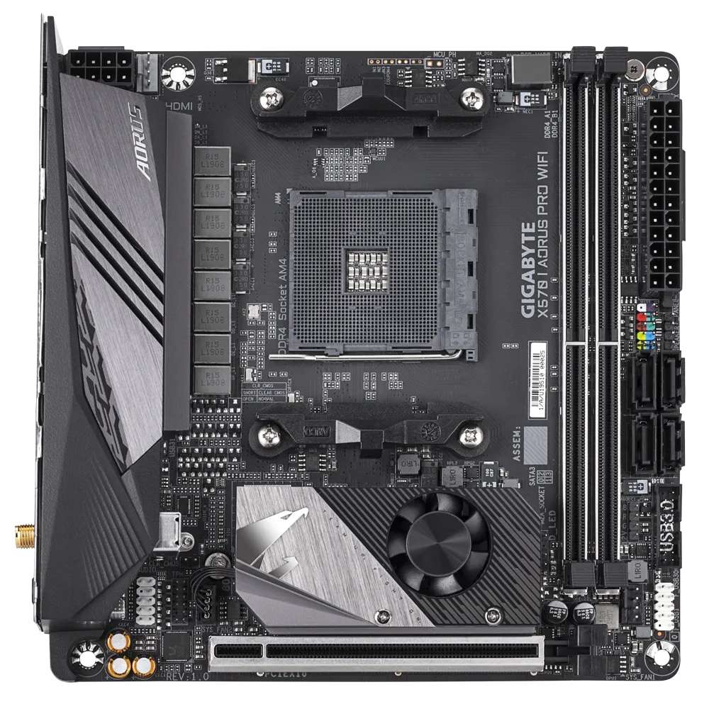
Mini-ITX Form Factor
Advantages
Typically measure 17cm x 17cm, which is ideal for small cases.
Often low cost.
Disadvantages
Small RAM Capacity.
Doesn’t support multi-GPUs.
Not suited for extreme overclocking

Slide 7
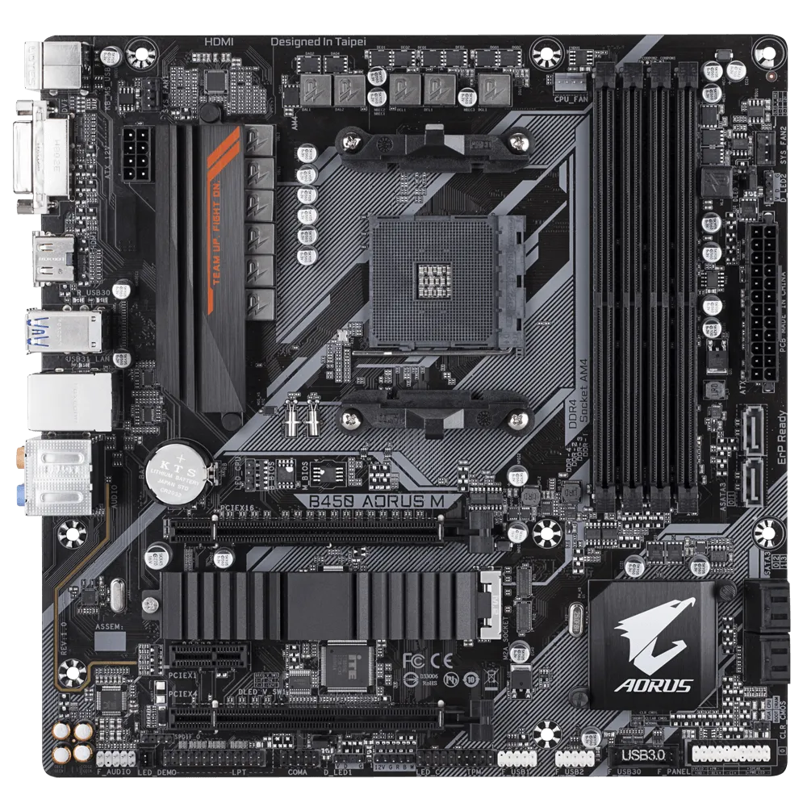
Micro-ATX Form Factor
Advantages
Slightly larger that Mini-ITX, can fit into most cases.
Ideal for any budget.
Disadvantages
Doesn’t support multi-GPUs.
Not suited for extreme overclocking

Slide 8
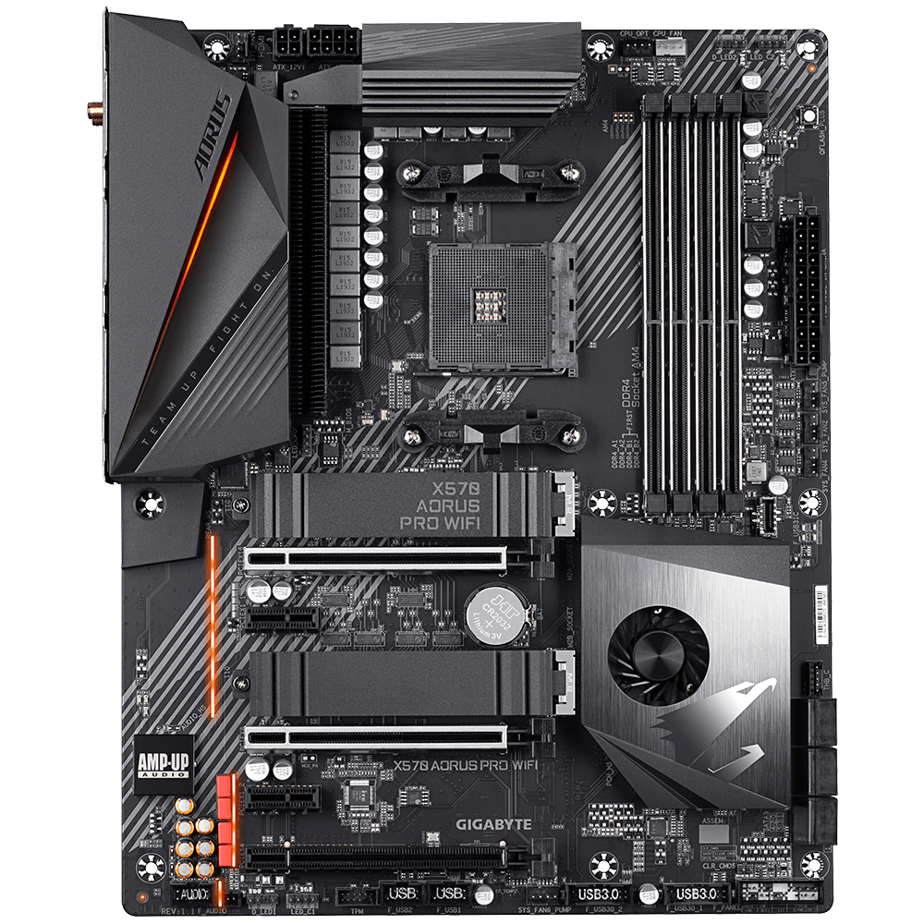
ATX Form Factor
Advantages
Higher RAM Capacity.
Suited for multi-GPU Support.
Better for extreme overclocking
Disadvantages
More expensive.
Typically measure 30.5cm x 24.4cm, which will not fit inside smaller cases.

Slide 9
BIOS (Basic Input Output System)
Is a software that instructs a computer on how to boot up the operating system.
Every motherboard has a BIOS pre-programmed into a chip. It’s different than an operating system. Operating systems can be installed, uninstalled, and updated long after you’ve bought the computer. BIOS is something that’s integrated into the computer while it’s being manufactured.

Slide 10
Parts of a Motherboard

Slide 11
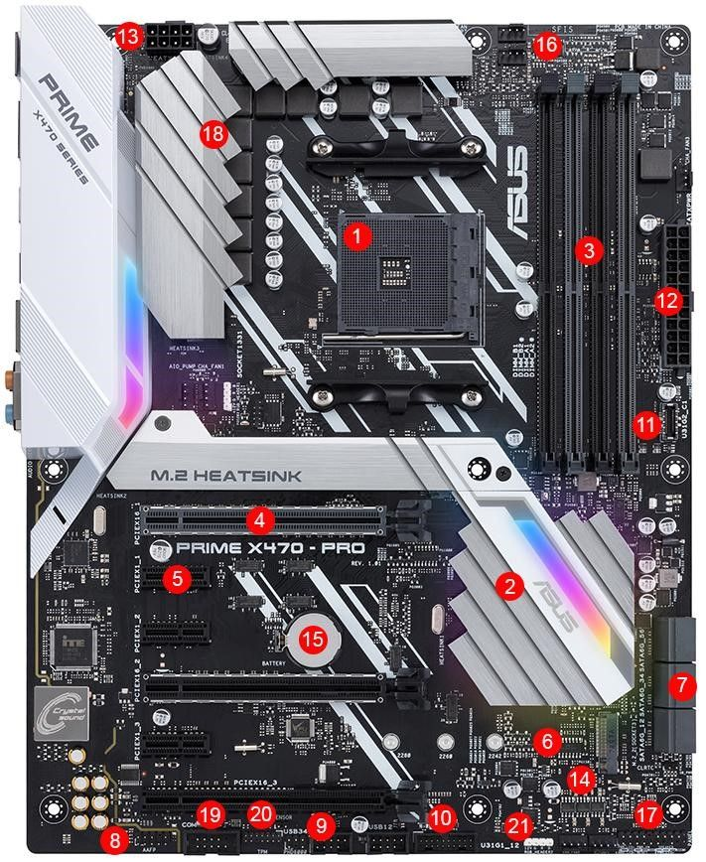
1. CPU Socket | 2. Chipset | 3. RAM slots
4. PCIe x16 slot | 5. PCI x1 slot | 6. M.2 connector
7. SATA ports | 8. Front panel connectors | 9. USB Header
10. USB 3.1 Gen1 header | 11. USB 3.1 Gen2 header | 12. ATX power connector
13. CPU power connector | 14. BIOS chips | 15. CMOS battery
16. Fan headers | 17. Front panel header | 18. VRM heatsink
19. COM/Serial header | 20. TPM header | 21. RGB header

Slide 12
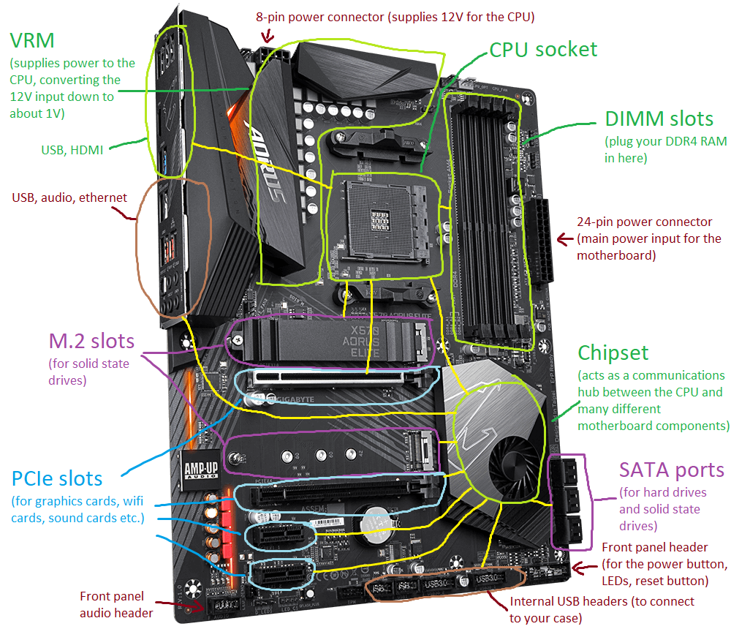

Slide 13
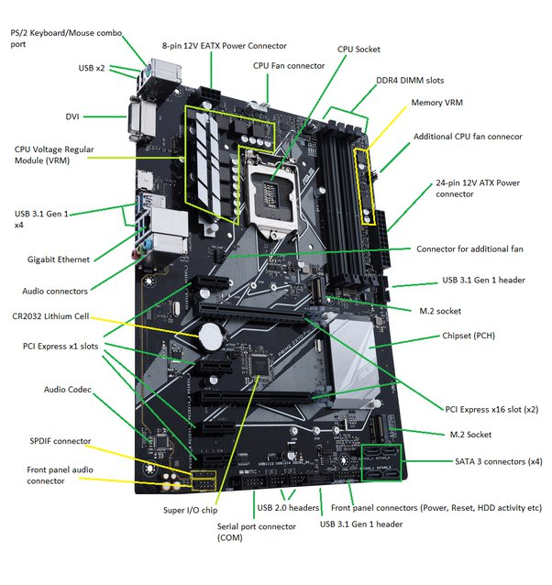

Slide 14
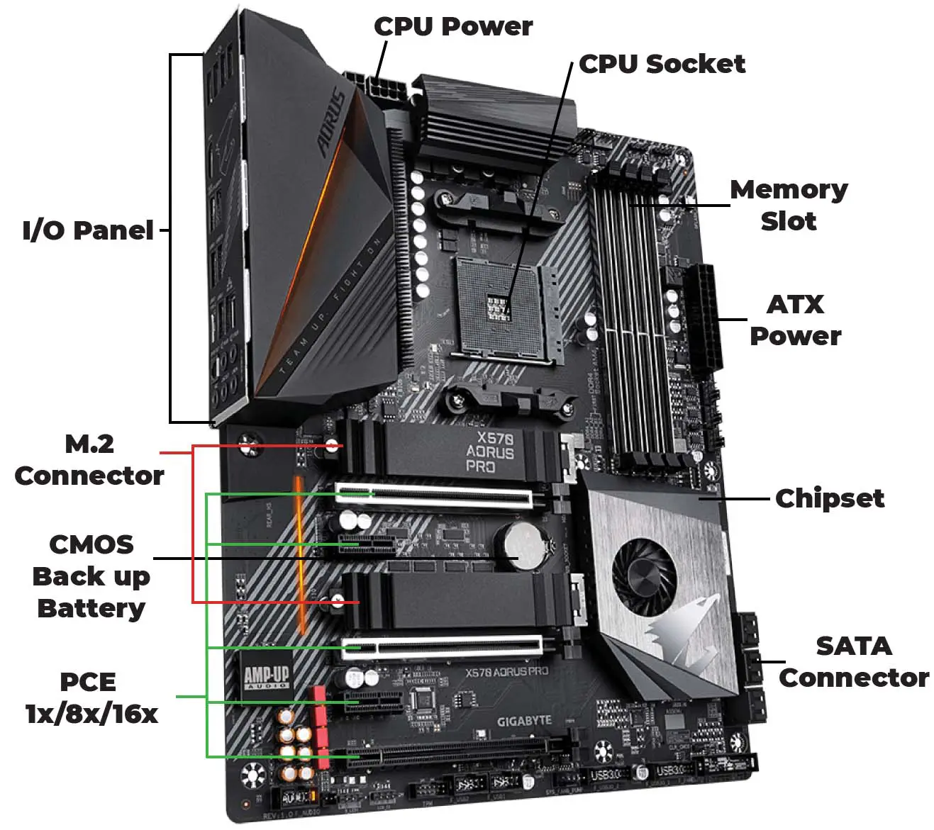

Slide 15
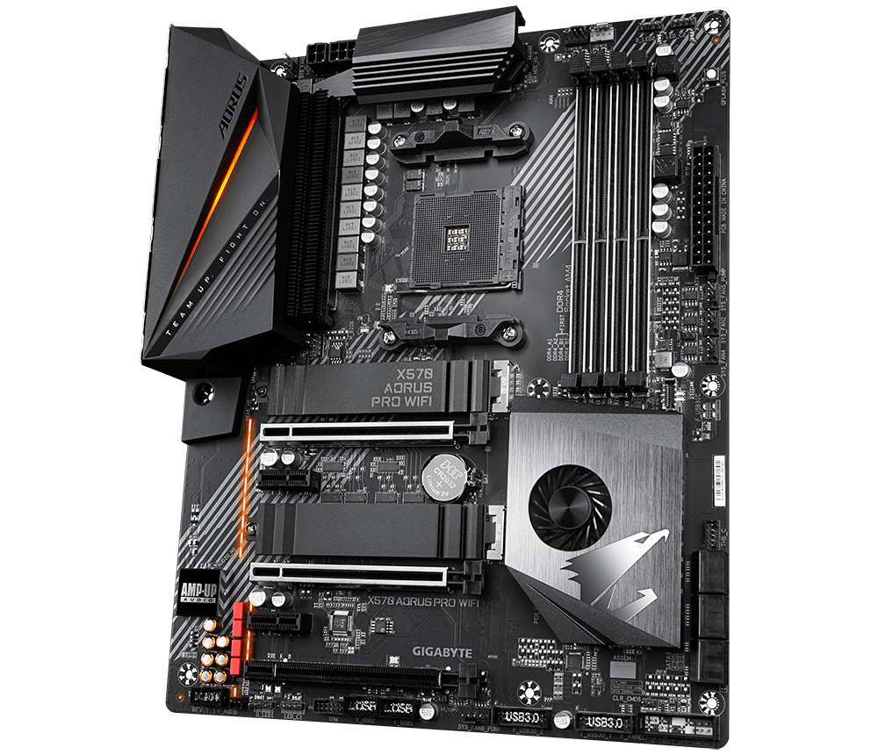

Slide 16
Chipset
An important component of a motherboard is the microprocessor's supporting chipset, which provides the supporting interfaces between the CPU and the various buses and external components. This chipset determines, to an extent, the features and capabilities of the motherboard.

Slide 17
Chipset

Slide 18
Chipset
Brand | Entry Level Class | Mid Range | Enthusiast Class
AMD | AMD A520 | AMD B550 | AMD X570
Intel | Intel H610 | Intel B660, H670 | Intel Z690
Enthusiast class chipsets are typically more expensive because they offer more features (e.g. overclocking, RAM Capacity, support for more number of USB ports)

Slide 19
CPU Socket
The CPU socket is where the CPU is installed.
It determines what kind of (CPU) the motherboard can use.
Common types of CPU sockets include the Pin Grid Array (PGA) and the Land Grid Array (LGA). The difference between the two is that PGA places the pins on the processor and the holes in the socket, whereas LGA has a socket with pins that you place the processor on.

Slide 20
CPU Socket

Slide 21
Power Connector
They are basically a virtual version of a CPU core.
Allows a CPU core to switch to multiple tasks (multitasking).

Slide 22
8 pin + 4 pin 12v ATX power connector
24 pin 12 volt ATX power connector

Slide 23
RAM(Memory) Slots
The memory slots are where you place the RAM.

Slide 24
Memory Slots

Slide 25
CMOS Battery
BIOS needs to remain operational even when your computer isn’t plugged into a power source. That’s where the CMOS battery comes in. When your computer gets unplugged, BIOS relies on the CMOS battery for power.
All the information and settings for the motherboard are stored in the BIOS. In order to save those information, the CMOS battery is needed.

Slide 26
CMOS Battery

Slide 27
Expansion Slots
Expansion slots are used to add extra components such as graphics cards/GPU, audio card, network card.
Extra components such as audio cards and network cards are only needed if the motherboard lack those features out of the box such as Wi-Fi connectivity.

Slide 28
Expansion Slots (PCI Express slots)

Slide 29
Back Panel Connectors
Also commonly referred to as I/O ports for short. These ports are located at the back of the computer.
Ports typically include USB ports, HDMI, Display Ports, DVI, VGA ports for display output, ethernet port, and audio ports (microphone, speakers).

Slide 30
Back Panel Connectors

Slide 31
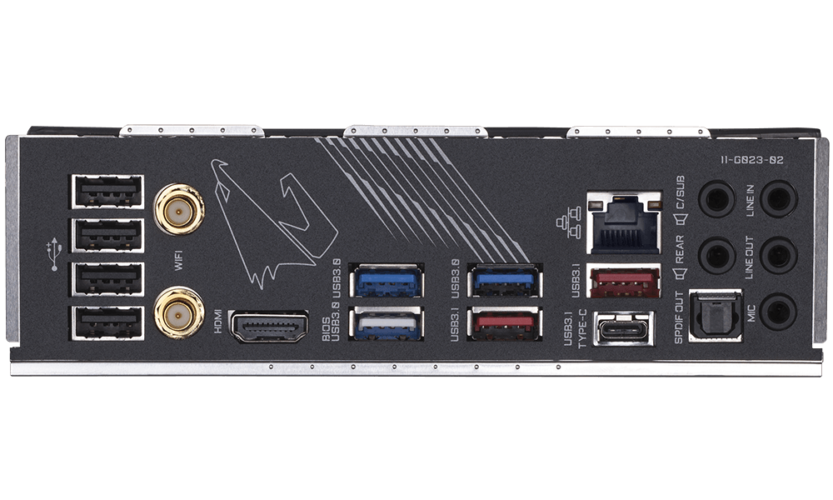
Ethernet
USB Ports
Audio Ports
HDMI Port
USB 3.0 Port
USB 3.1 Port
USB Type-C Port

Slide 32
Front I/O Connectors
This is where you connect the power switch, LED power indicator, reset switch, and the HDD LED cables. The front audio port and front USB are also connected here. These connections are usually located at the bottom part of the motherboard.

Slide 33
Front I/O Connectors

Slide 34
Storage Interface
The storage device connectors are where you will connect your storage devices, such as mechanical hard drives and solid-state drives. These storage devices need to be connected to the motherboard for data to be submitted and retrieved.

Slide 35
M.2 Slots
SATA Connectors

Slide 36
Screw Holes
Holes used to mount the motherboard to a computer case.

Slide 37
Screw Hole
Screw Hole
Screw Hole
Screw Hole
Screw Hole
Screw Hole

